Slide 1
Feed and Bunk Analysis using Computer Vision
Jean Niwenshuti
David Fernández Expósito
John Vu

Slide 2
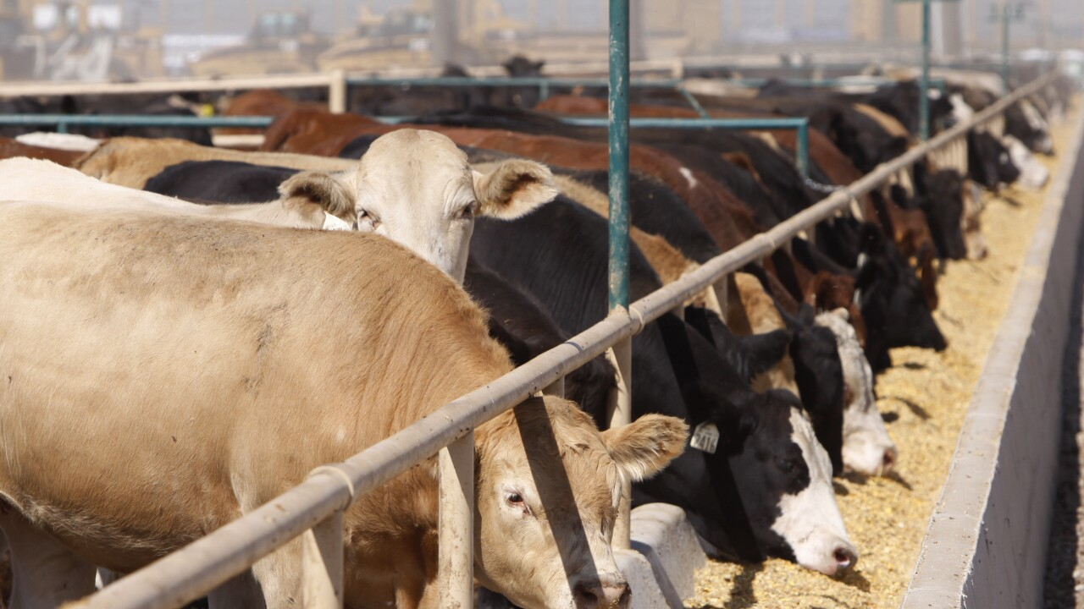
Background
Motivation
Feedlots are large beef cattle feeding operations
Feed bunk management is crucial for feedlot production
Monitoring feed intake
Estimating feed conversion
Reduce feed waste and spoilage
Currently, Feed bunk management relies on skilled labor to estimate feed (manual observation)
Computer vision can be used to build an alternative tool to support feedlot managers

Slide 3
Goal
Objectives
Use segmentation techniques to identify the feed in the bunk and classify the type of feed
Detect whether there is feed or no feed in the bunk using deep learning
Locate the feed using texture segmentation
Detect the type of feed and corresponding bulk density value using deep learning

Slide 4
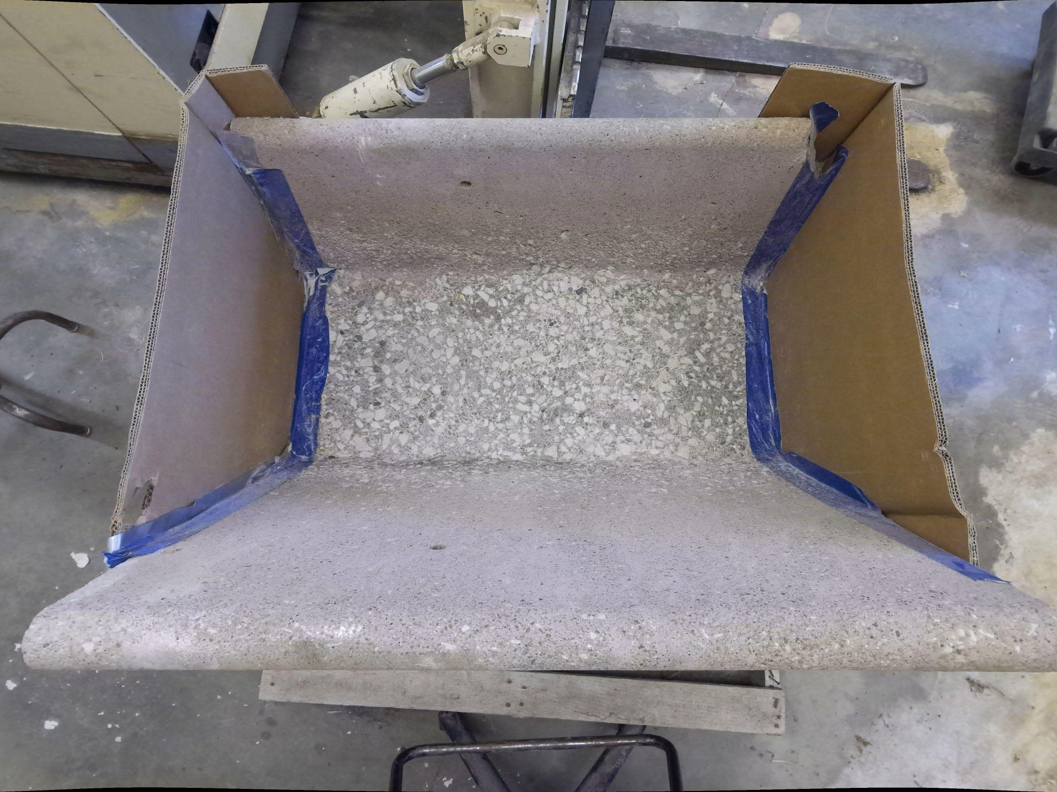
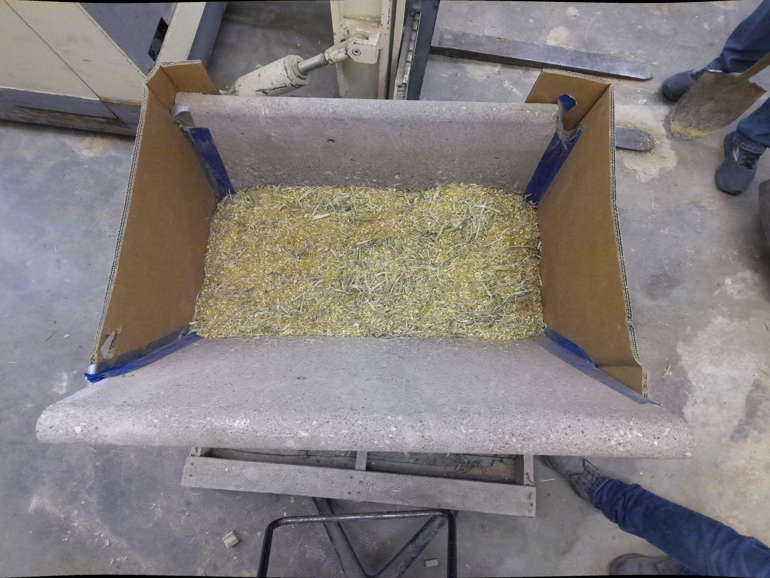
Material and methods
Image size 3072x4096 pixels
7 common fed diets in Nebraska
Image acquisition conducted at Animal Science lab at UNL
Software used MATLAB and Visual Studio
2 datasets were used
Dataset 1 for detecting the feed
Dataset 2 for identifying the type of feed
Classification neural network

Slide 5
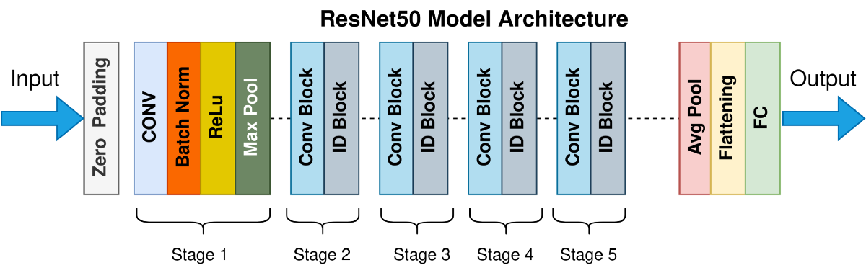
Material and methods
Transfer learning method (Deep network designer)
Commonly used in deep learning
Uses a pre-trained deep learning model to learn new parameters
ResNet50 was used for this study

Slide 6
Materials and methods
ResNet 50 (Residual Network)
Introduced in 2016, ‘Deep Residual Learning for Image Recognition [1]’
Deep learning model that creates identity shortcut links to skip layers
Reduces the problem of disappearing gradients by allowing them to go through these shortcut channels
Trained on ImageNet dataset with up to 152 layers
The deep network achieved 3.57% error
Won the 1st place in ILSVRC & COCO 2015 competitions

Slide 7
Material and methods
ResNet50 training
178 total layers
Modified the full connected
Added 2 full connected
Added a softmax
Classification output
Trained on 2 different datasets
Feed or No feed
Type of feed

Slide 8
Detect whether there is feed or no feed in the bunk using deep learning

Slide 9
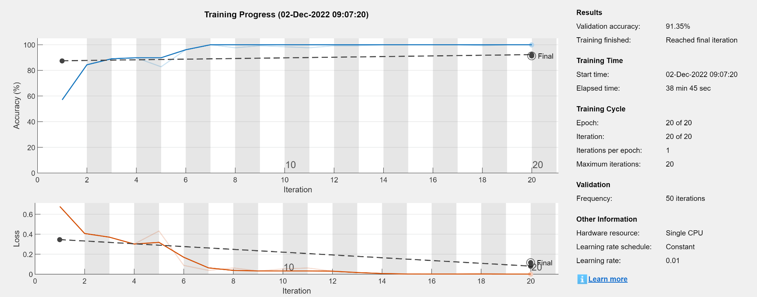
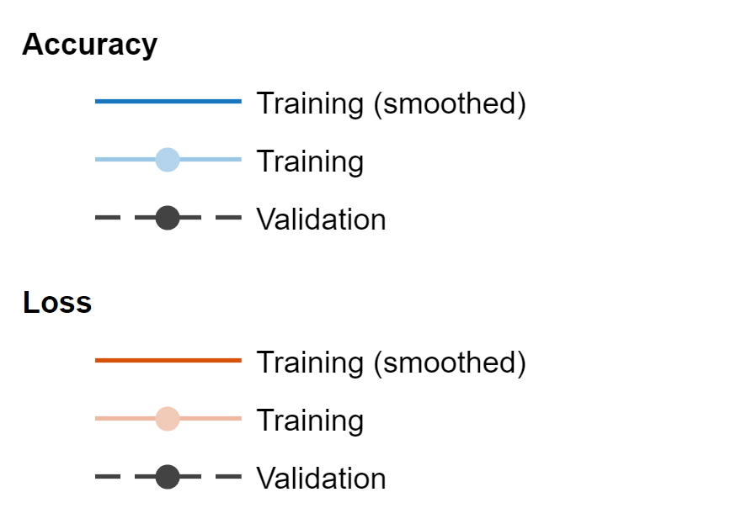
Deep network set-up
Dataset
2 classes of images: Feed and No feed
Image sizes: 3072x4096x3
Resized to 224x224x3 before training
Training
42 images of feed bunk with no feed
300 images of feed bunk with feed
Augmentation of data 30% (rescale and rotation)
70% data to train and 30% data to validate
Validation accuracy: 91.3%
Validation loss: 0.12

Slide 10
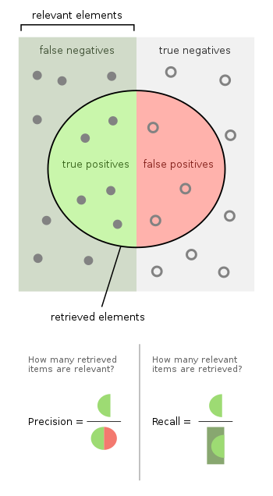
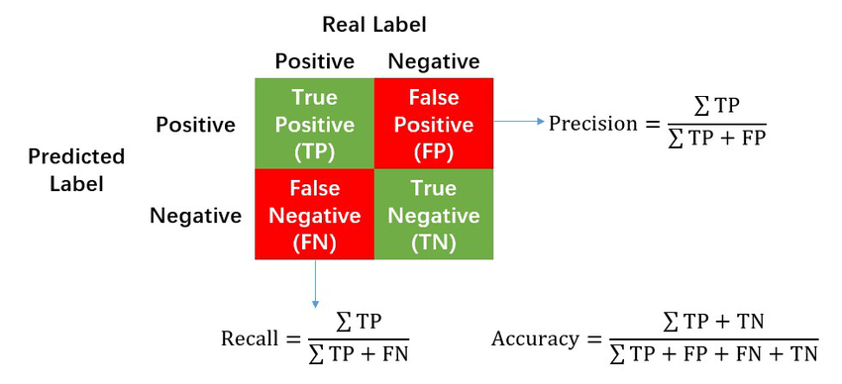
Model analysis
Prediction > 95% means there is feed
Test Data set: 72 images
F1 score = 0.9043
Precision = 1
Accuracy = 0.8472
Recall = 0.8254
Source: https://www.researchgate.net/figure/Calculation-of-Precision-Recall-and-Accuracy-in-the-confusion-matrix_fig3_336402347

Slide 11
Locate the feed using texture segmentation

Slide 12
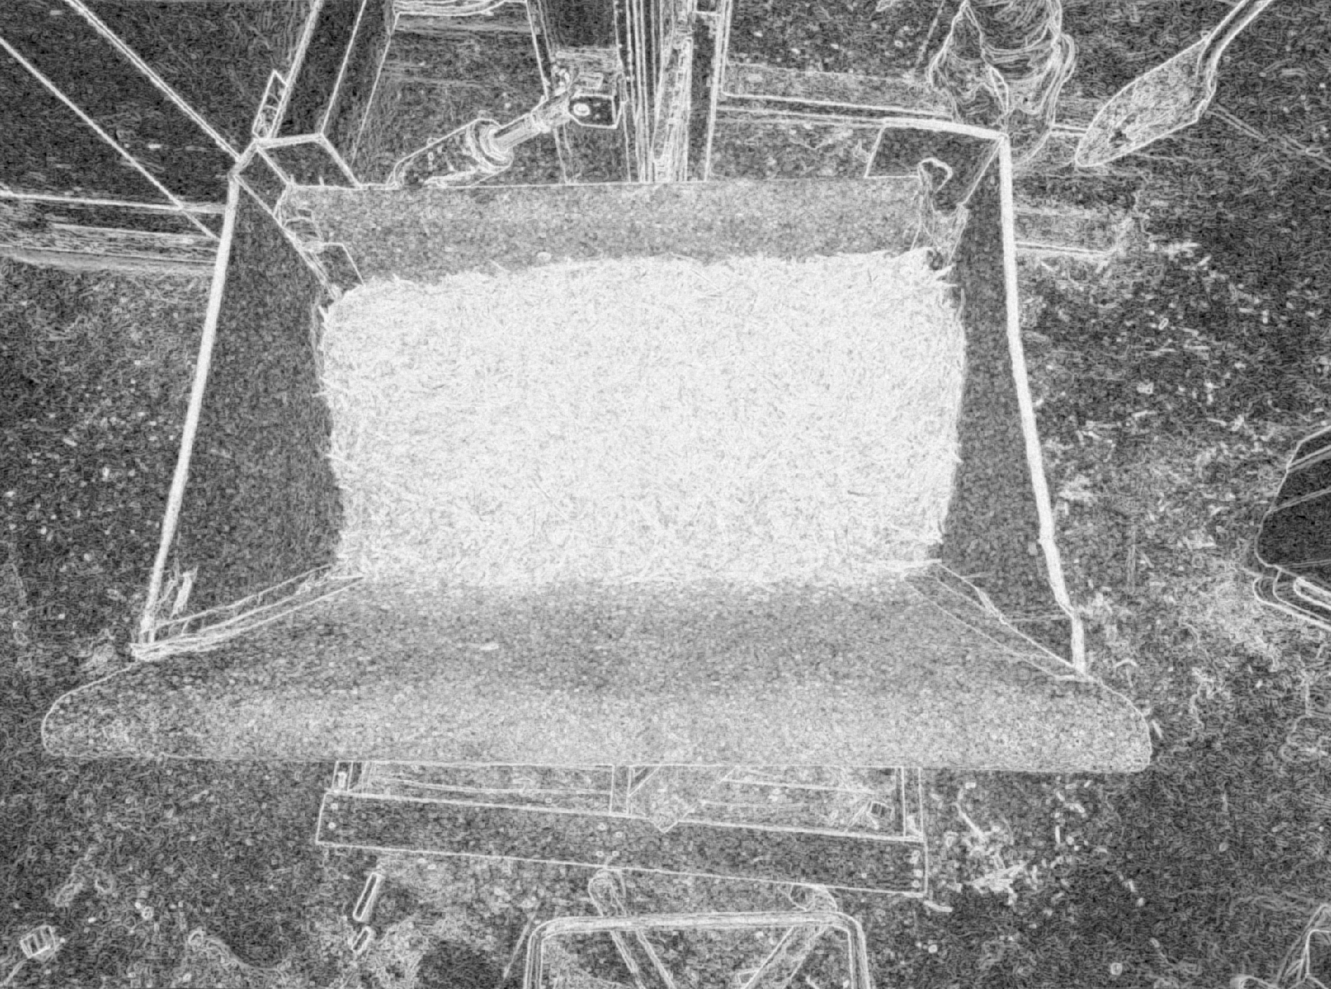
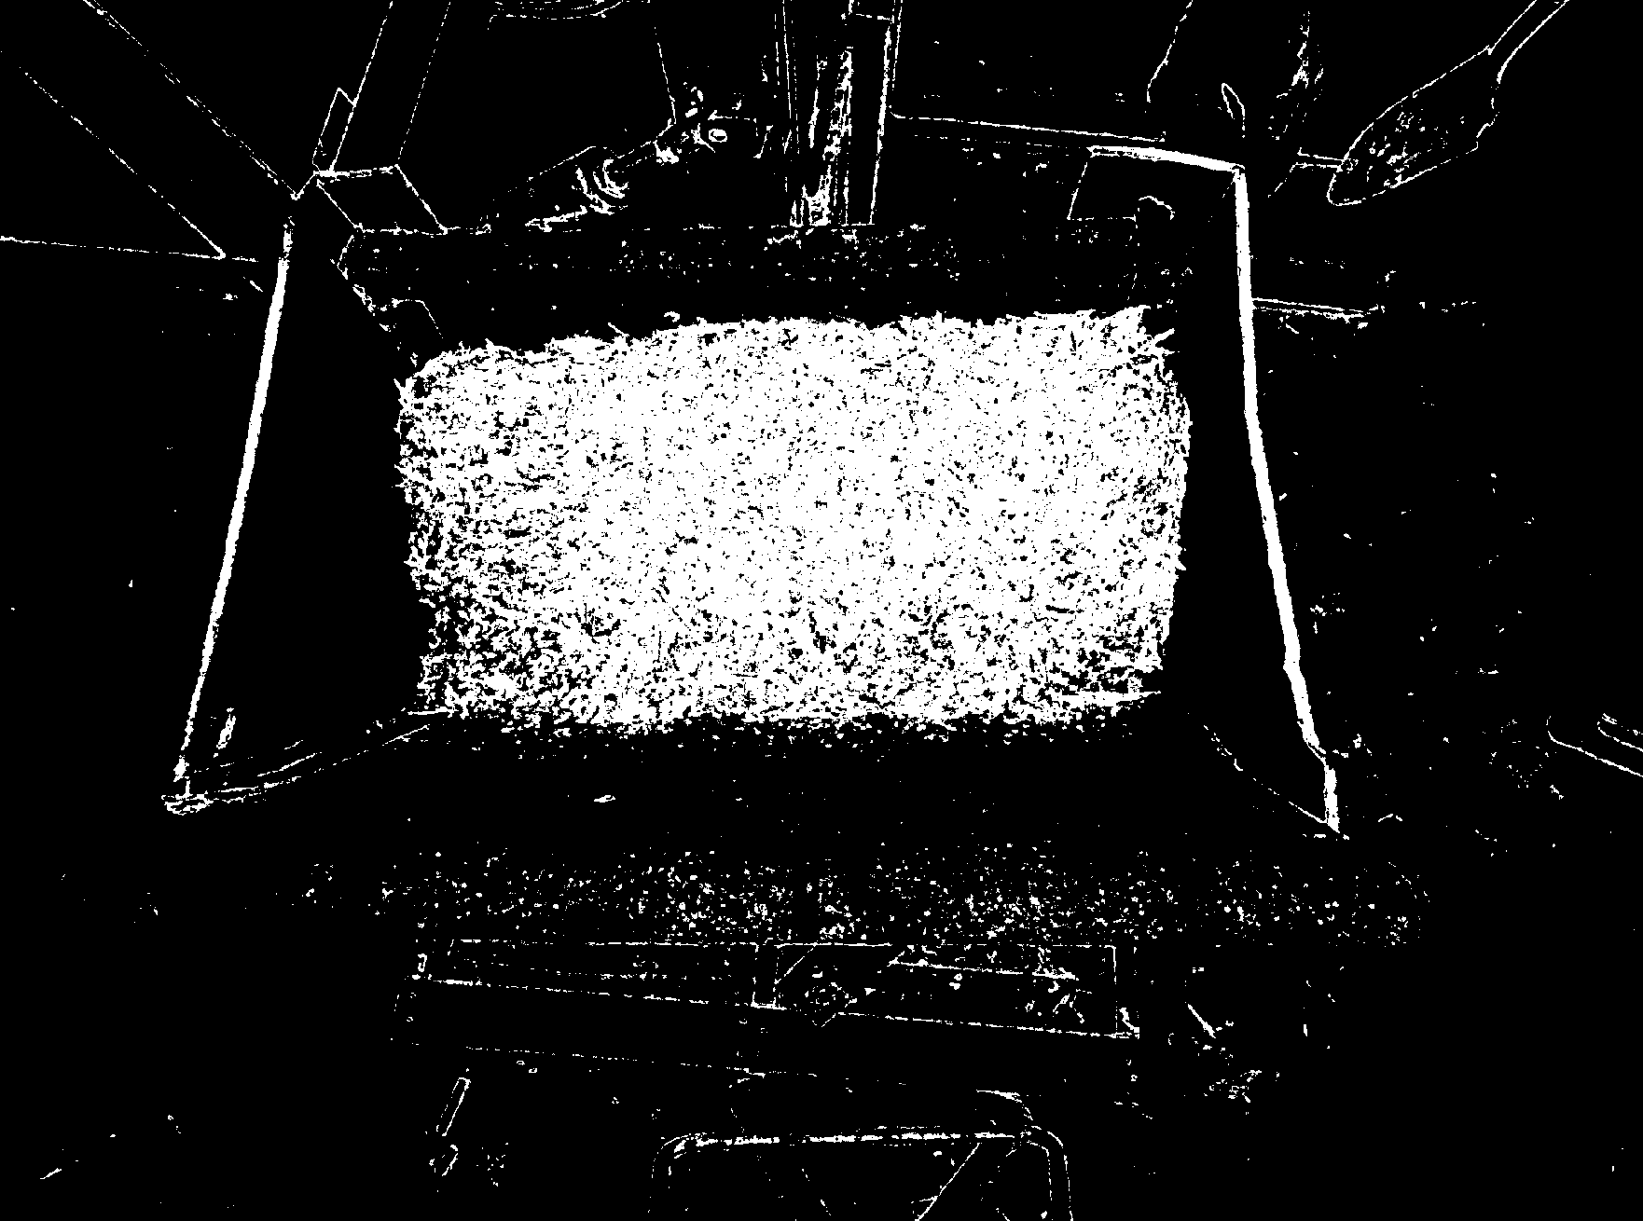
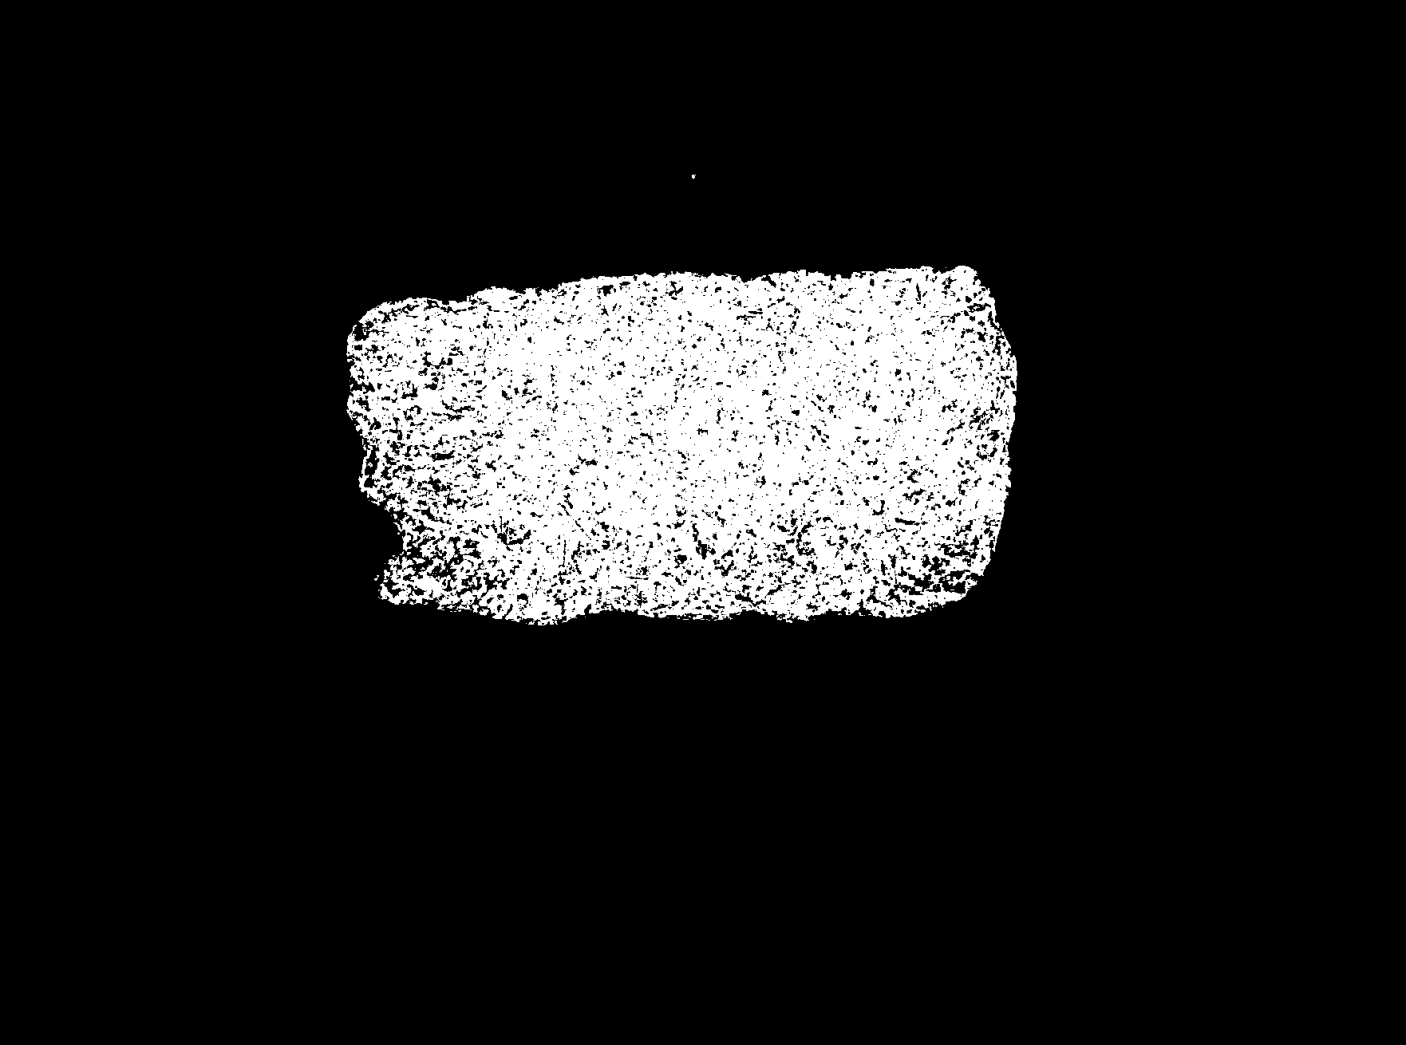
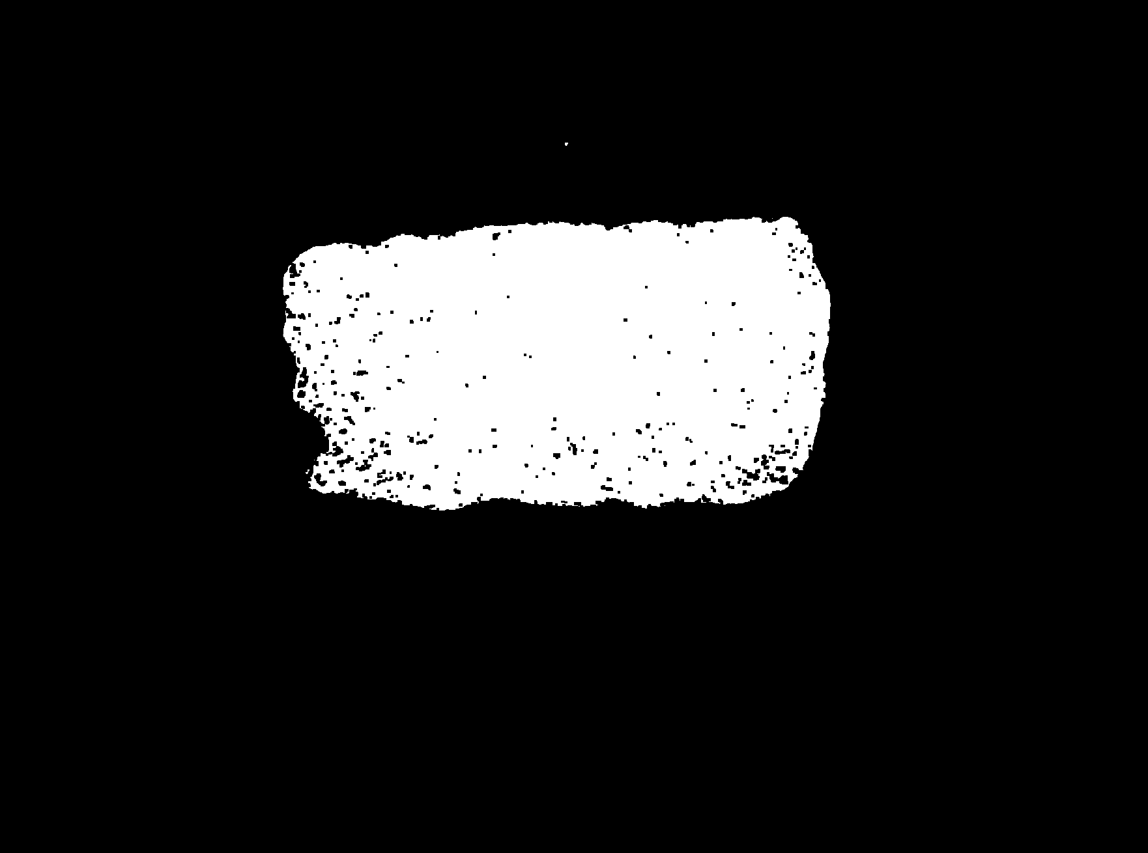
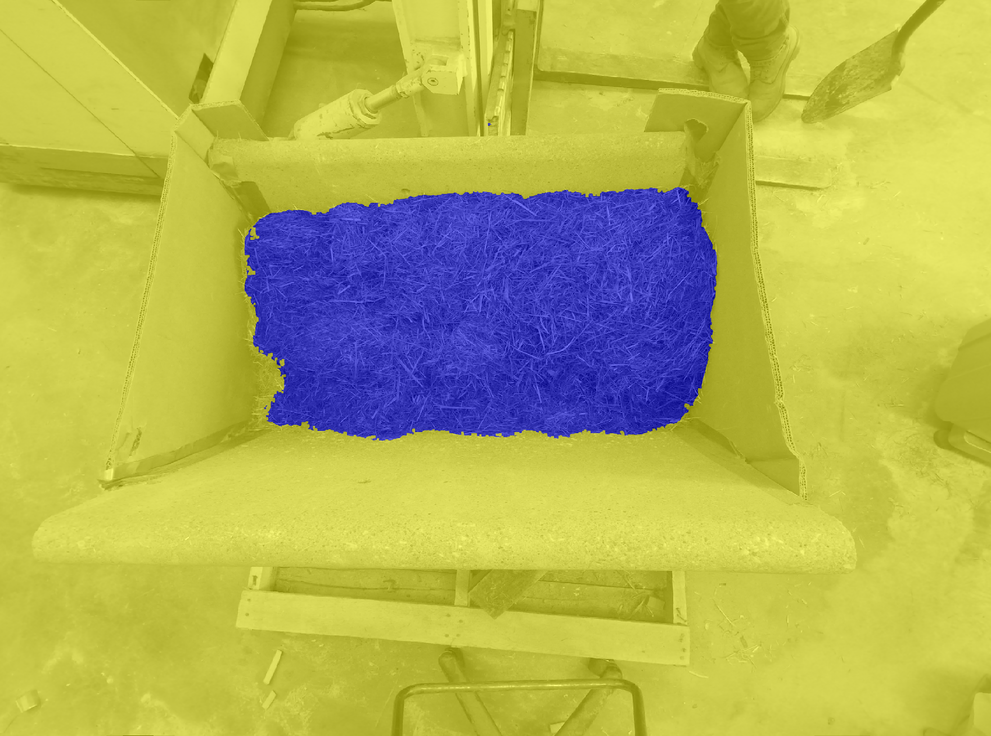
Texture segmentation algorithm
Compute entropy
Threshold entropy matrix
Eliminate unwanted points
Smooth the edges
Fill remaining holes

Slide 13
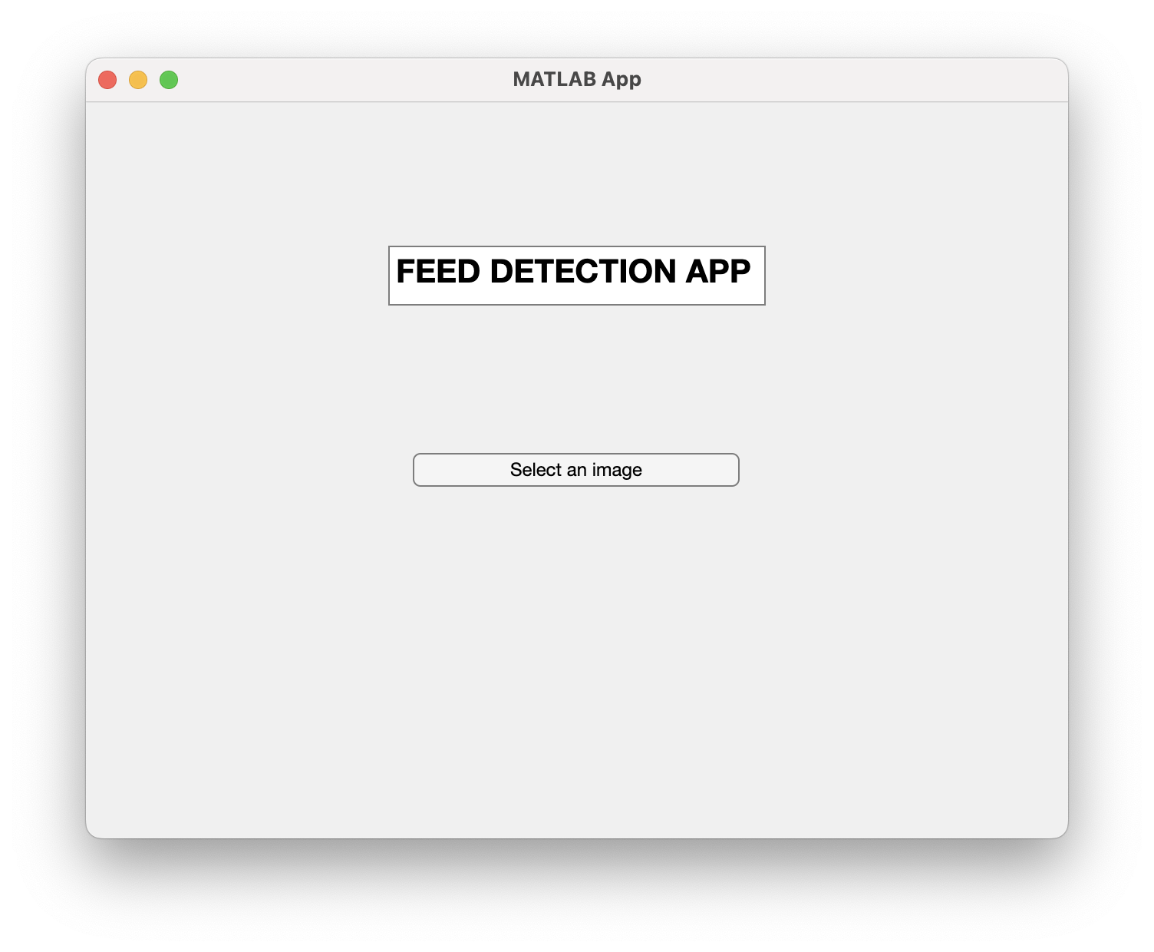
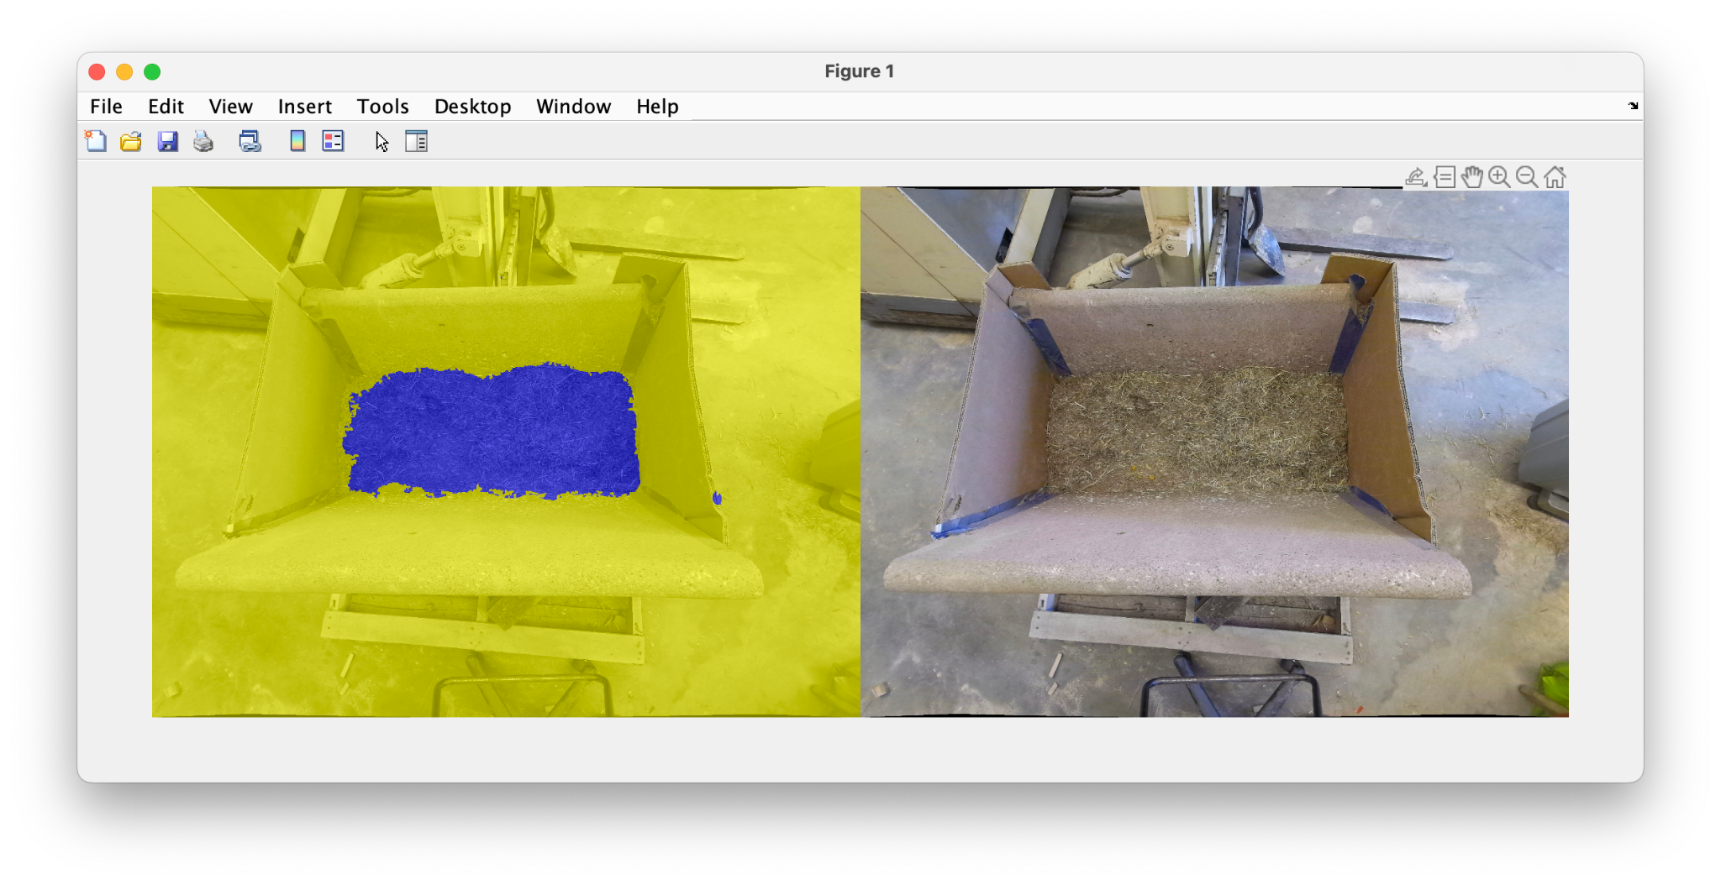
Texture segmentation app
We created a simple app that used the texture segmentation algorithm

Slide 14
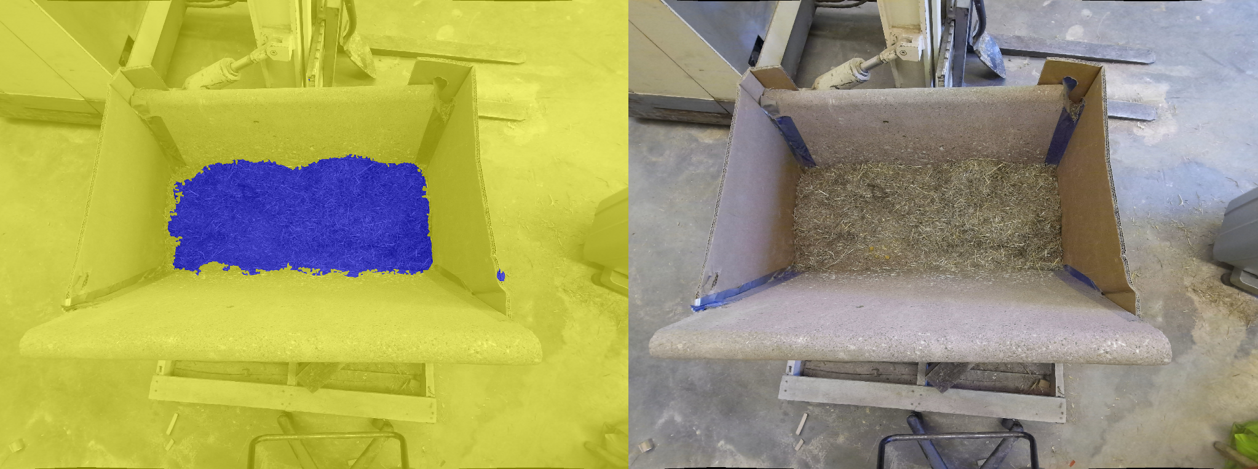
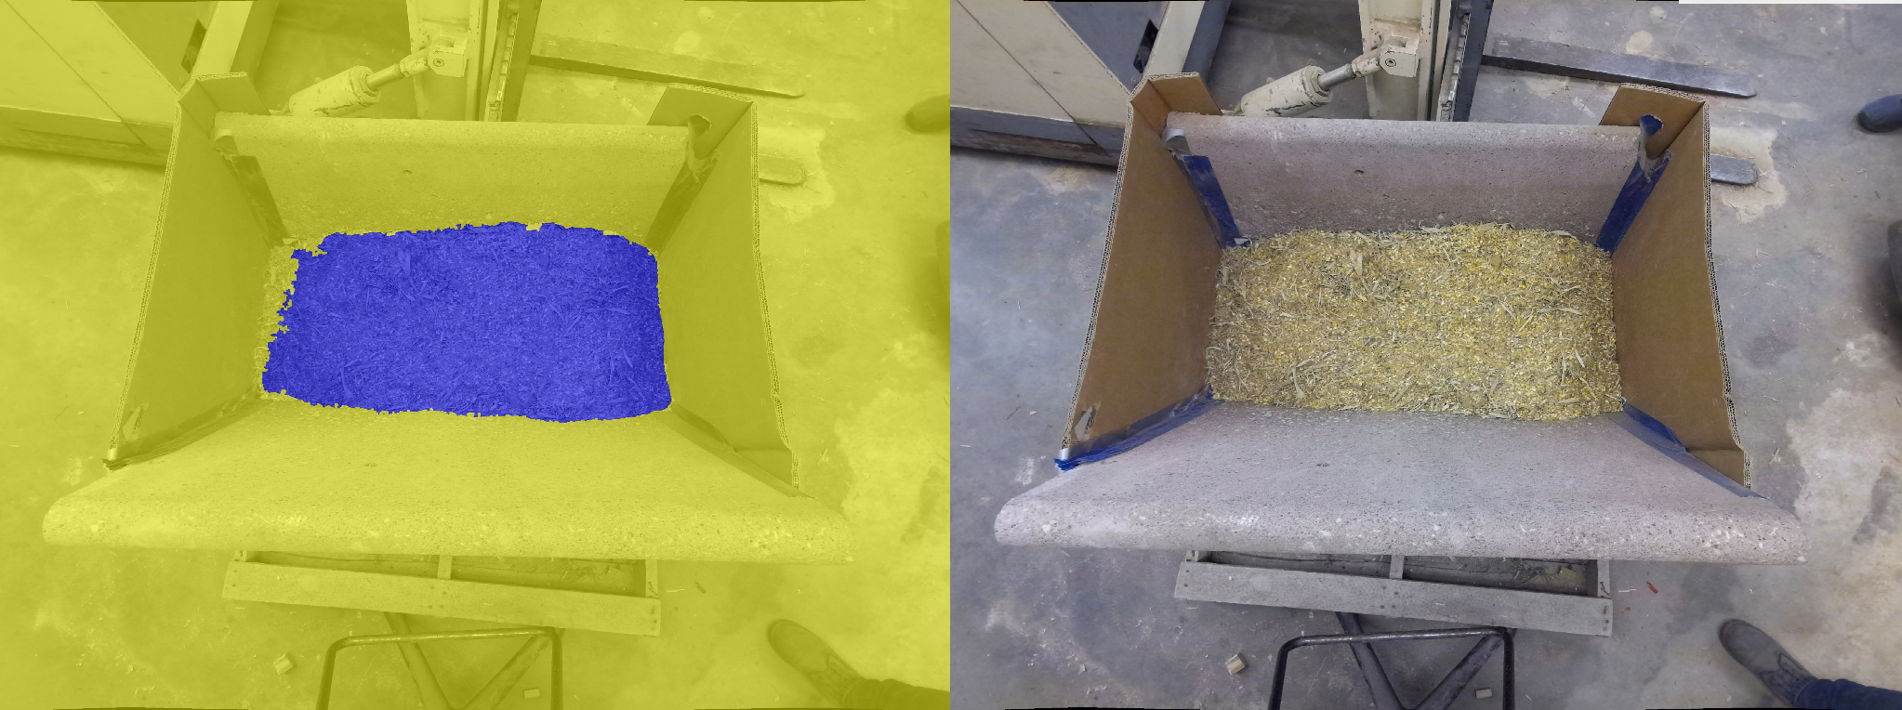
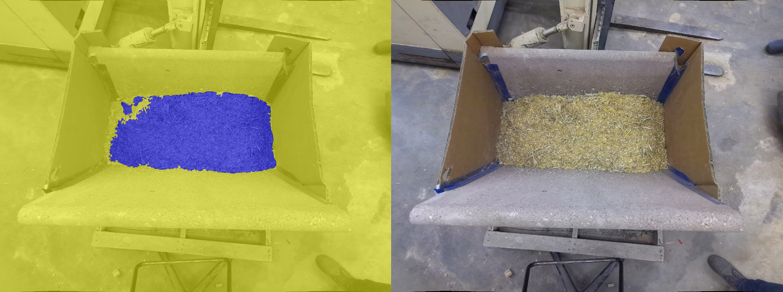
Algorithm output

Slide 15

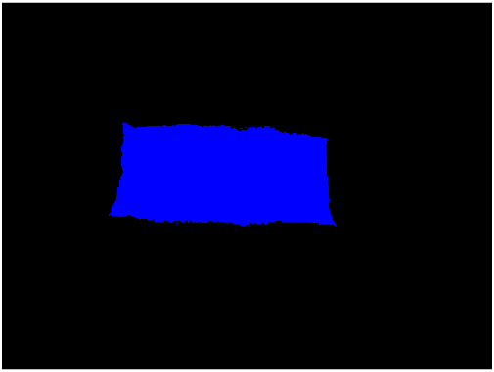
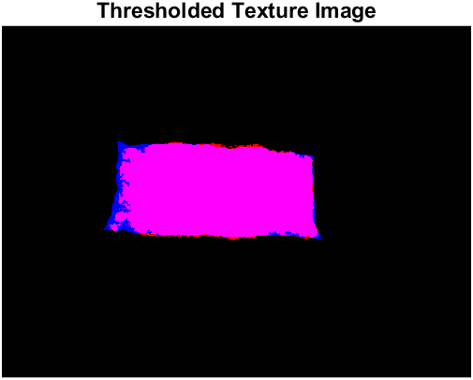
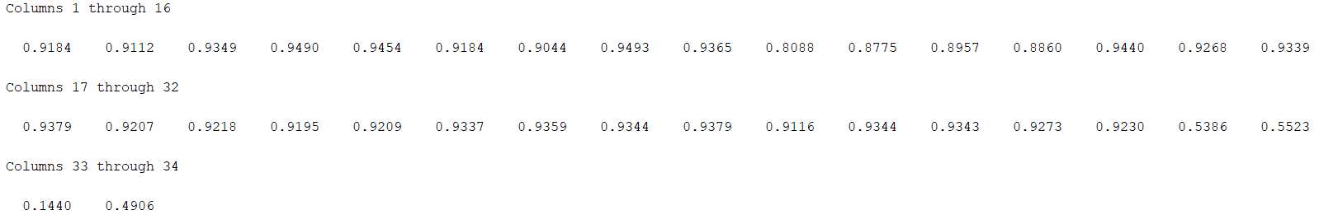
Texture segmentation analysis
We used Intersection over Union (IoU) metric.
Mean IoU = .8635
Low score with almost empty bunk
IoU

Slide 16
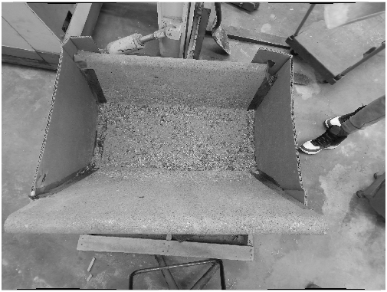
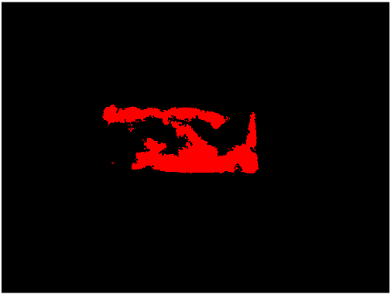
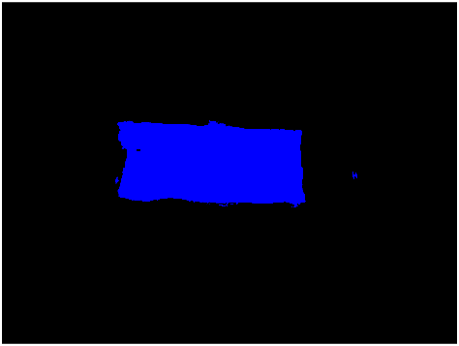
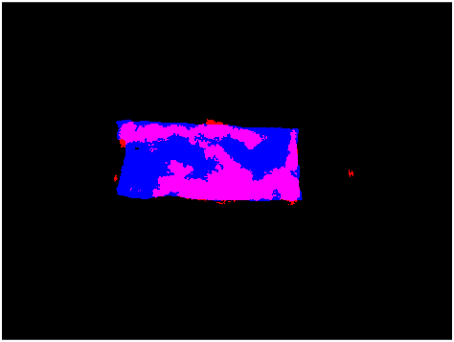
Texture segmentation analysis
High performance with full bunk
Low Performance with low to empty bunk

Slide 17
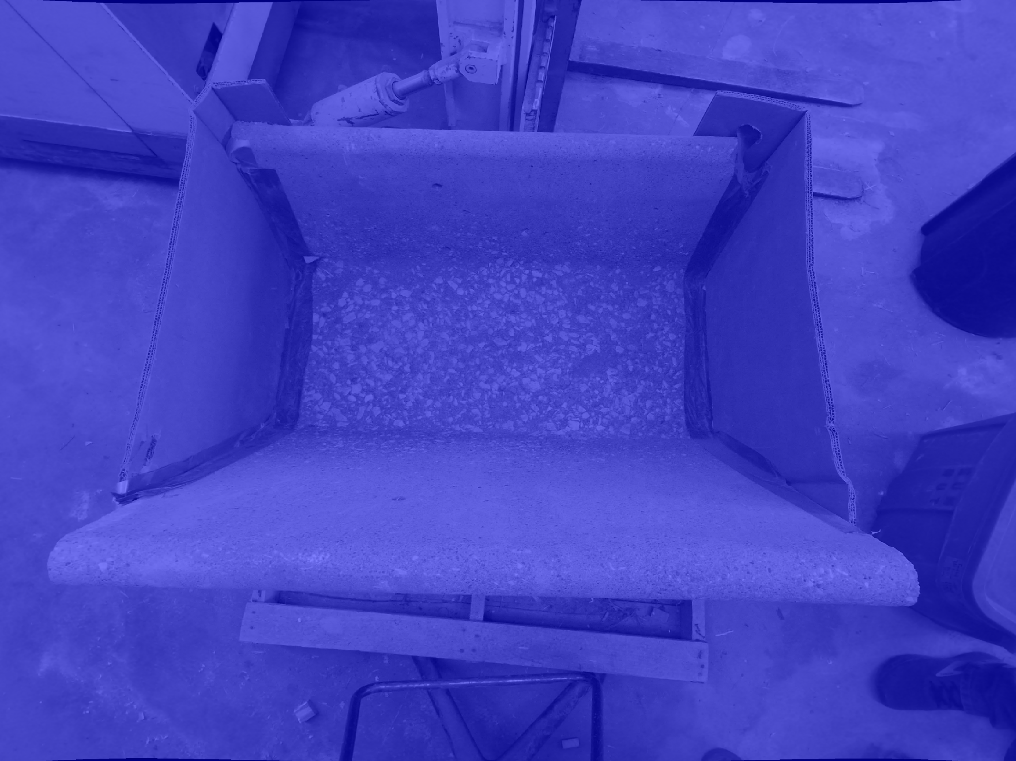
Note!
Texture segmentation can be used to detect if the is feed in the bunk or not

Slide 18
Detect the type of feed and corresponding bulk density value using deep learning

Slide 19
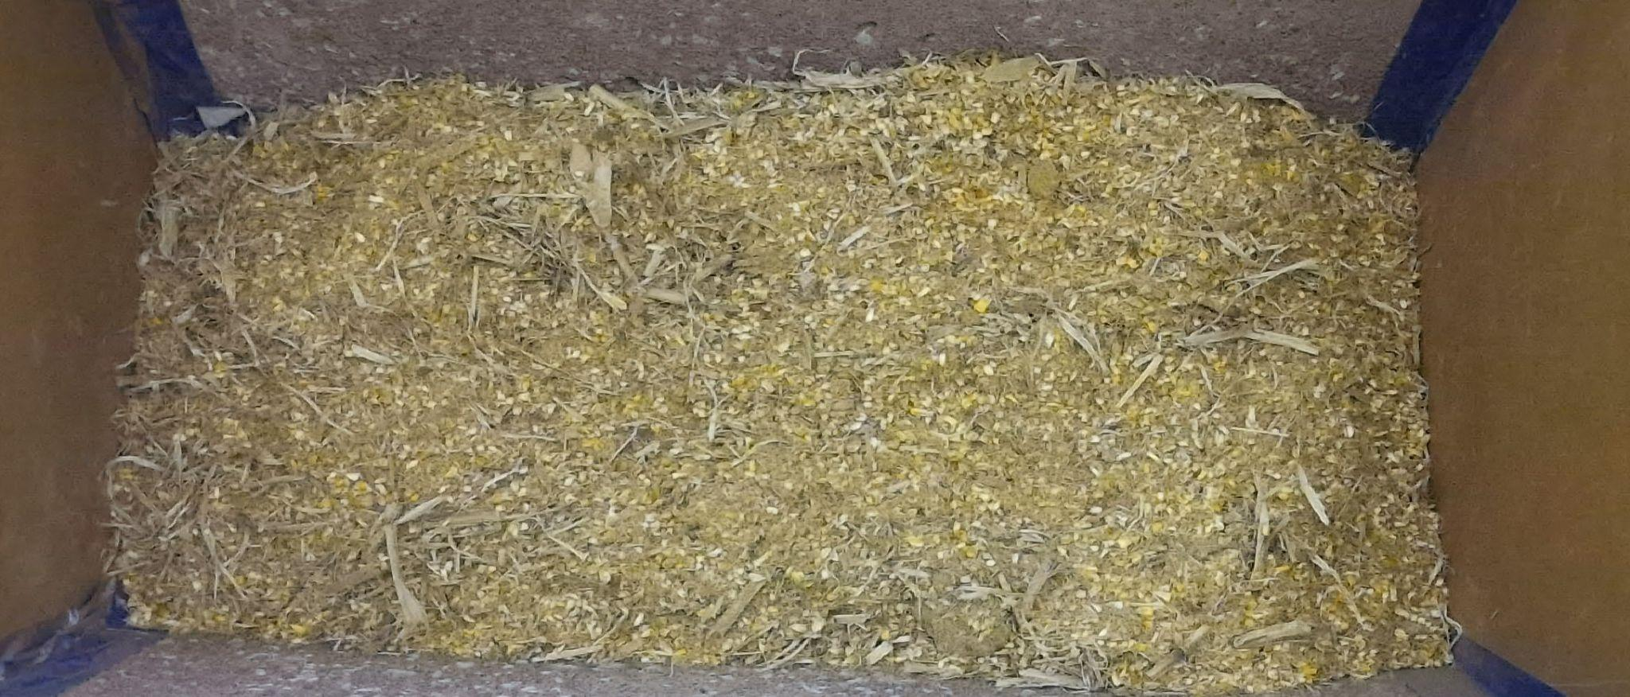
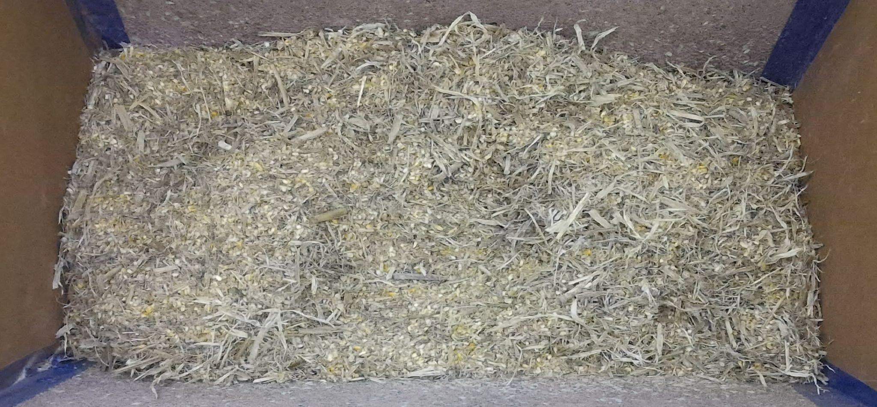
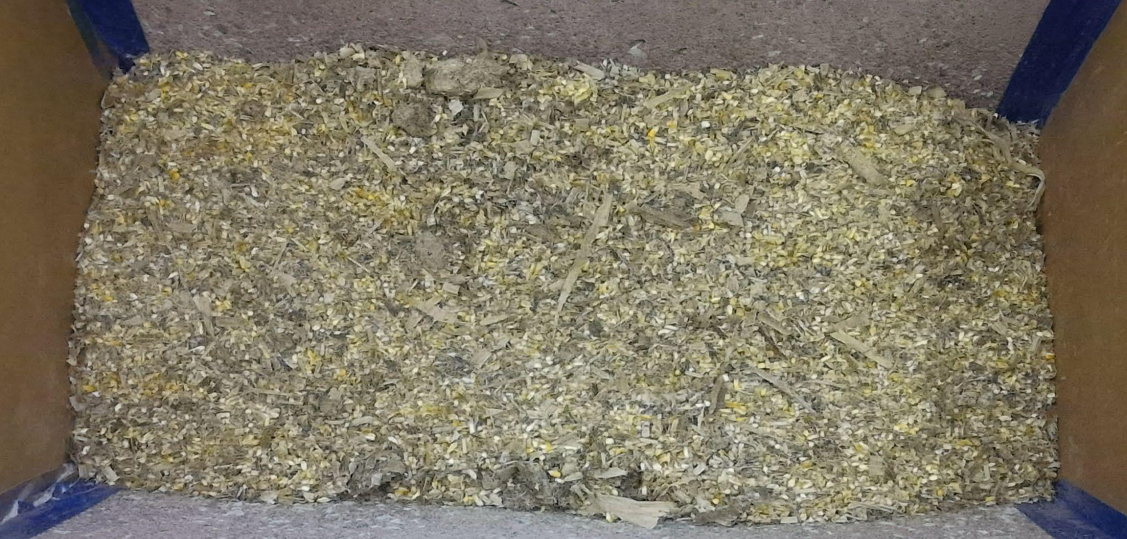
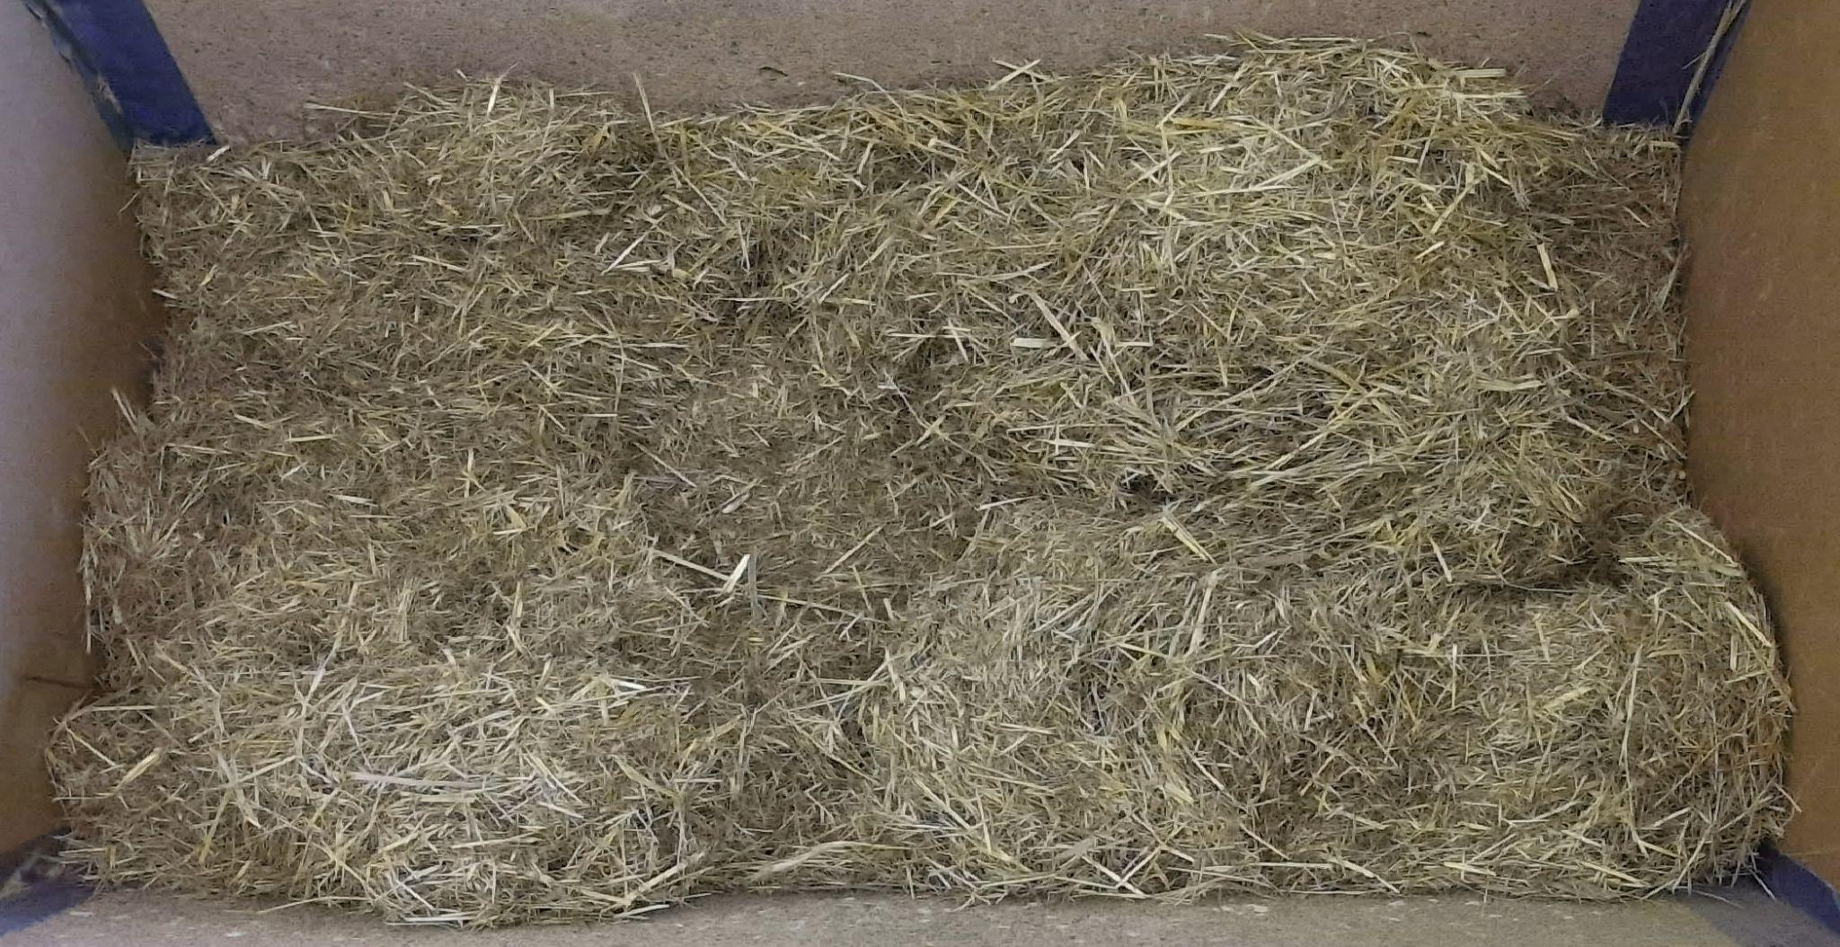
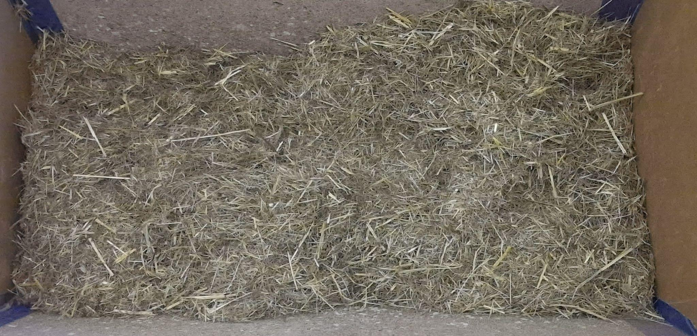
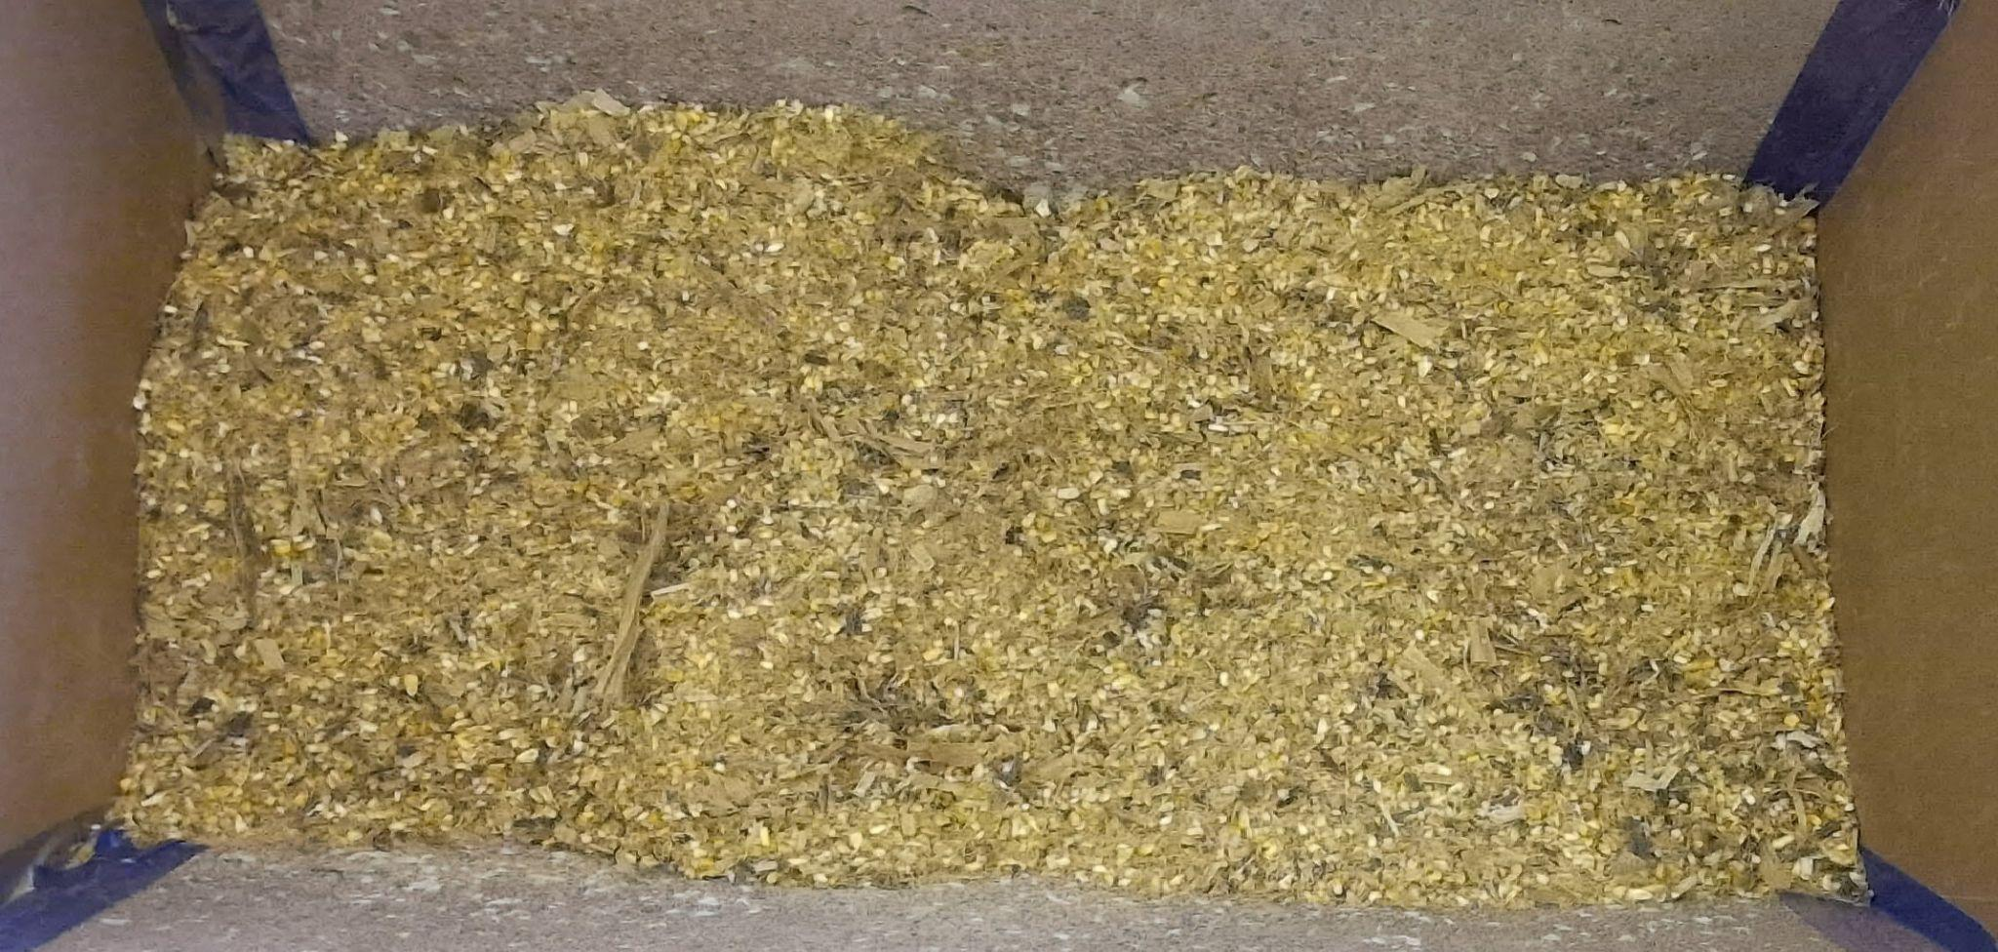
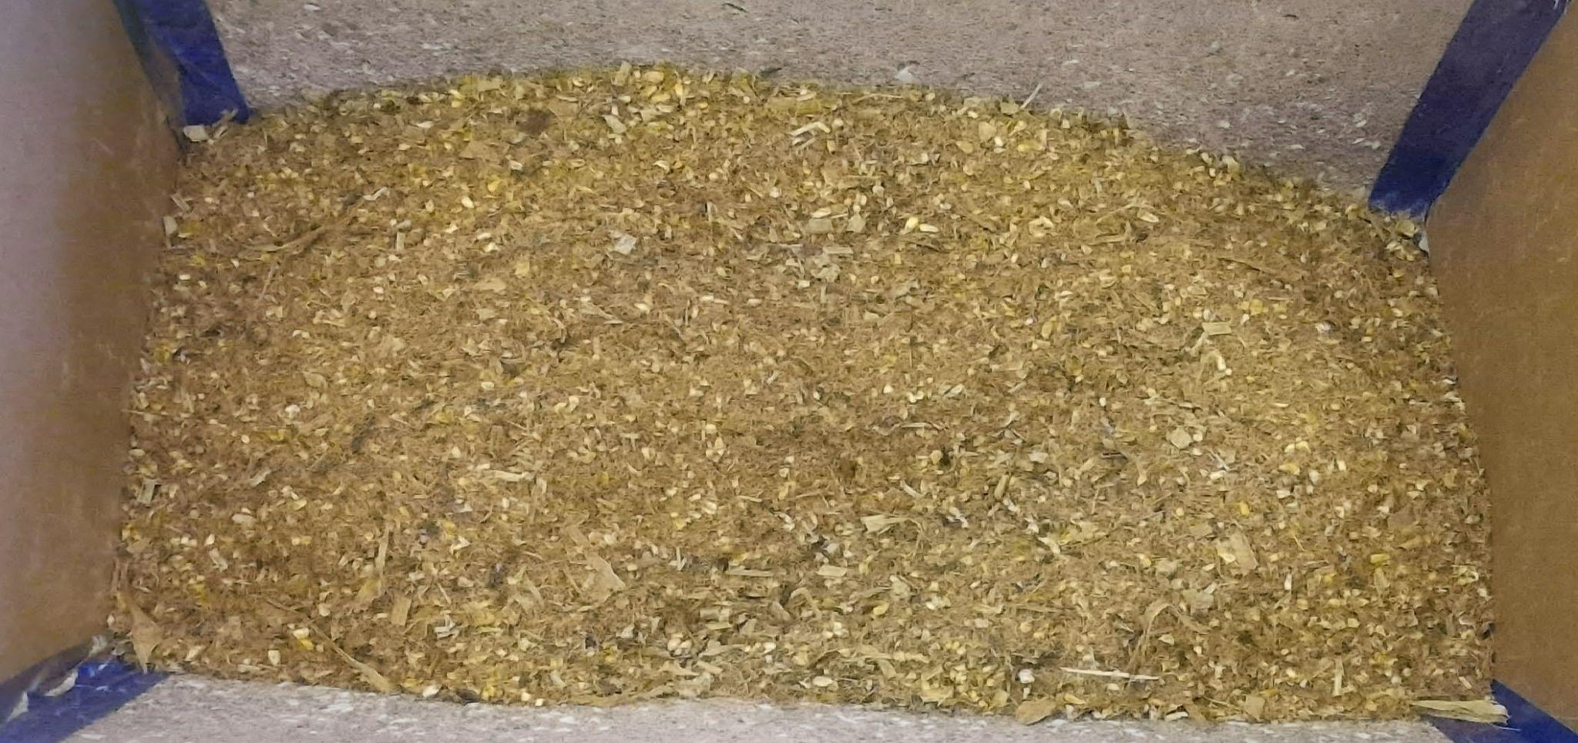
Classification dataset
Class 1: Diet (1)
Class 2: Diet (2)
Class 3: Diet (3)
Class 4: Diet (4)
Class 5: Diet (5)
Class 6: Diet (6)
Class 7: Diet (7)

Slide 20
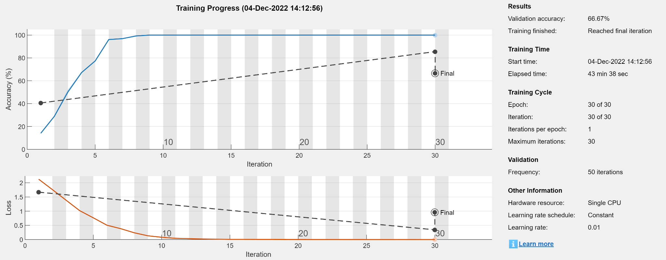
Deep network set-up 1
Dataset
7 classes of images: CB Stalks : 15 MDGS Finisher, CB Stalks : 0 MDGS Finisher, CB CS: 0 MDGS Finisher, Merck High Systems, Merck Low, CB CS: 15 MDGS Finisher, and 500/600 Finisher
Image sizes: 3072x4096x3
Resized to 224x224x3 before training
Training
30 images per class
Augmentation of data 30% (rescale and rotation)
70% data to train and 30% data to validate
Validation accuracy: 66.67%

Slide 21
Classification dataset 2
Class 1
Diet (1)
Diet (2)
Diet (3)
Class 2
Diet (4)
Diet (5)
Class 3
Diet (7)
Diet (6)

Slide 22
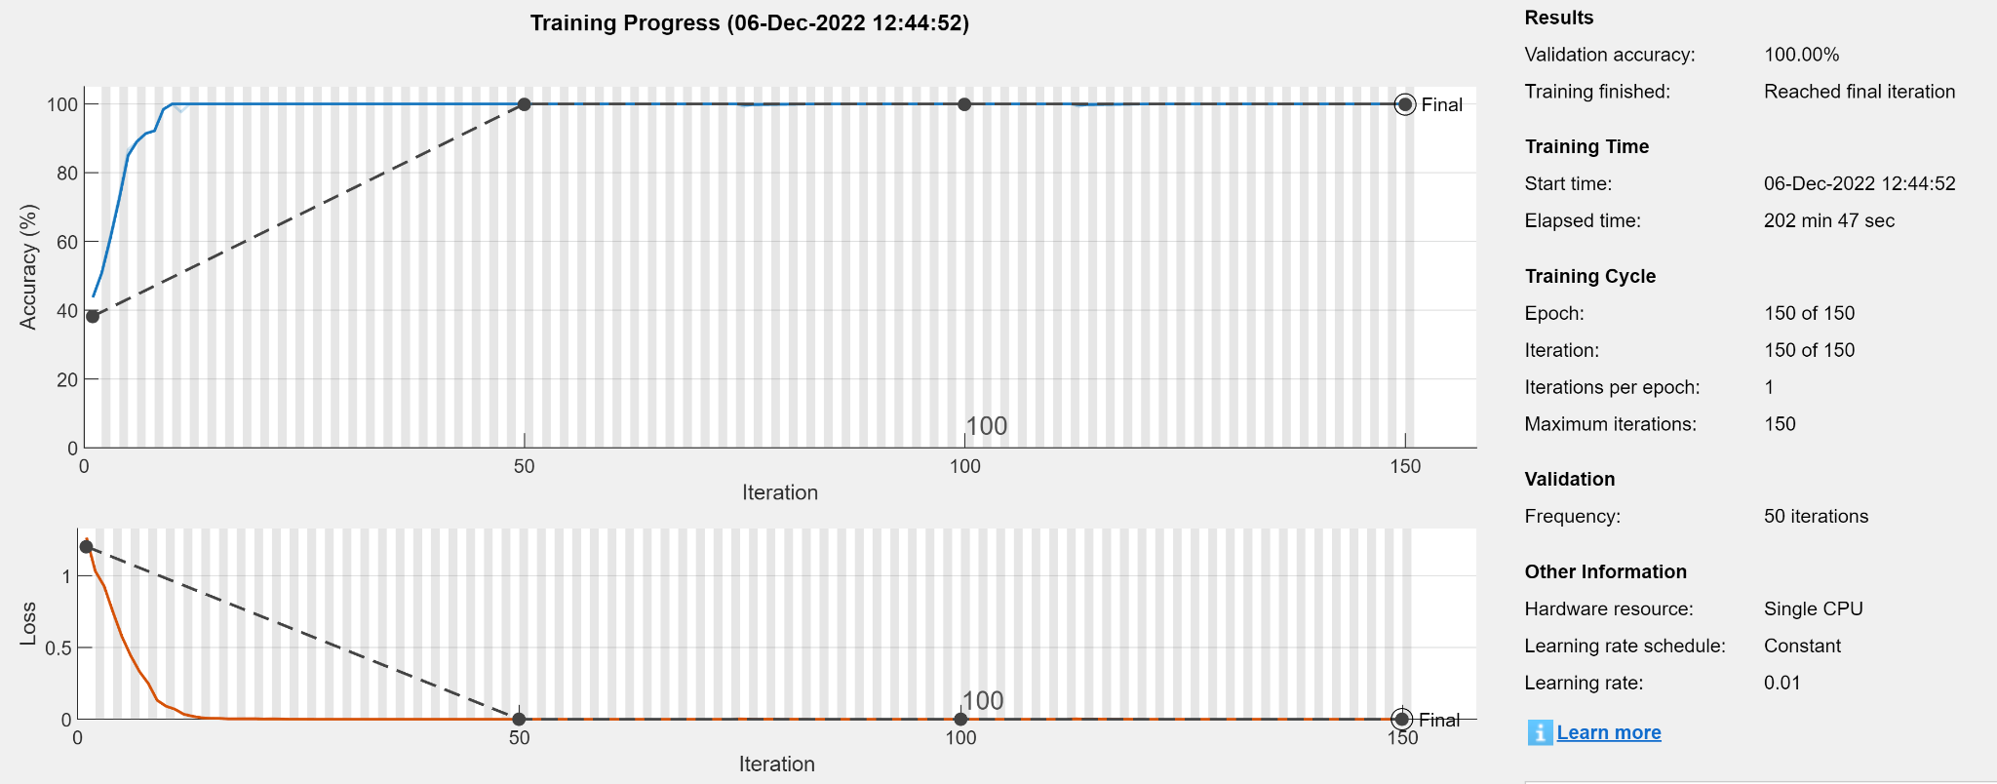
Deep network set-up 1
Dataset
3 classes of images:
Class 1 : CB Stalks : 15 MDGS Finisher, CB Stalks : 0 MDGS Finisher, and CB CS: 0 MDGS Finisher
Class 2: Merck High Systems and Merck Low
Class 3: CB CS: 15 MDGS Finisher, and 500/600 Finisher
Training
50 images per class
Augmentation of data 30% (rescale, rotation, blur, and pixel translation)
70% data to train and 30% data to validate
Validation accuracy: 100%
Validation loss: 5.3e-5

Slide 23
Model analysis
Use Max value to determine the type of feed
Test Data set: 87 images
F1 score= 1
Precision = 1
Accuracy = 1
Recall = 1
Source: https://www.researchgate.net/figure/Calculation-of-Precision-Recall-and-Accuracy-in-the-confusion-matrix_fig3_336402347

Slide 24
Discussion/Conclusion
Texture segmentation had an average accuracy (IoU) of 86.35% on detecting regions in the image with feed
Deep learning method had an accuracy (CM) of 84.7% to identify if there is any feed in the bunk
Increasing the number of layers and iteration can increase the accuracy of the deep learning model
Deep learning for Types of feed is good but further testing is needed
Suggestion: Deep learning might not be necessary

Slide 25
Future work
Increase the number of images in each class
Further explore feed detection using texture segmentation.
Apply the mask on the depth map to estimate the volume
Obtain Testing and Training data in different environments and lightings

Slide 26
Reference
Kaiming He, Xiangyu Zhang, Shaoqing Ren, Jian Sun; Proceedings of the IEEE Conference on Computer Vision and Pattern Recognition (CVPR), 2016, pp. 770-778

Slide 27
Summary
Objective | Evaluation metric | Results
1. Detecting Feed | Confusion Matrix | 84.7%
2. Texture Filtering | Intersection over Union | 86.35%
3. Detecting Type of Feed | Confusion Matrix | 100%

